Slide 1


Department of Artificial Intelligence and Data science
Analyzing Social Media content to Identify Factors Driving Viral Video Propagation
By- Venkata Sai.V
221801060
Praveen.B
221801503
Under the guidance of Y.Nirmala Anandhi (AP)
Dept of AI&DS

Slide 2
Problem Statement and Motivation
A digital media company aims to analyze viral video propagation by studying social media content and user interactions. They aim to identify factors contributing to video virality.

Slide 3
Objectives
To examine how viral video spreads by examining user interactions on social media sites.
To measures share rates, the frequency of comments and likes, and the impact of network architecture on the distribution of material.
To maximize the production of digital media by utilizing these insights.
To study what makes material go viral. It can target influencers and high-engagement people to increase reach.

Slide 4
Abstract
Machine learning models, including logistic regression and neural networks, analyze YouTube video metrics such as views, likes, dislikes, and comments to predict video virality. The system processes data, trains models, and evaluates their performance through metrics like accuracy and precision. An interactive website allows users to input YouTube video URLs, extract relevant metrics, and receive insights on factors driving the video's virality along with personalized recommendations for improvement.

Slide 5
Introduction and Overview of the Project.
Viral video has to greatly influence audience reach and engagement in the world of digital media.
The goal of this study is to identify the elements that lead to content viral by
examining user interactions and social media sharing trends.
The initiative attempts to optimize video strategies, improving the company's to develop highly shareable and engaging media by analyzing how content distributes and identifying important drivers.

Slide 6
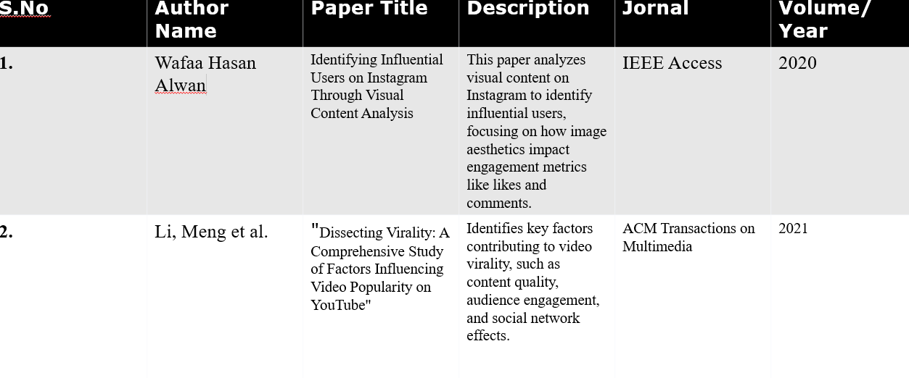
Literature Survey

Slide 7
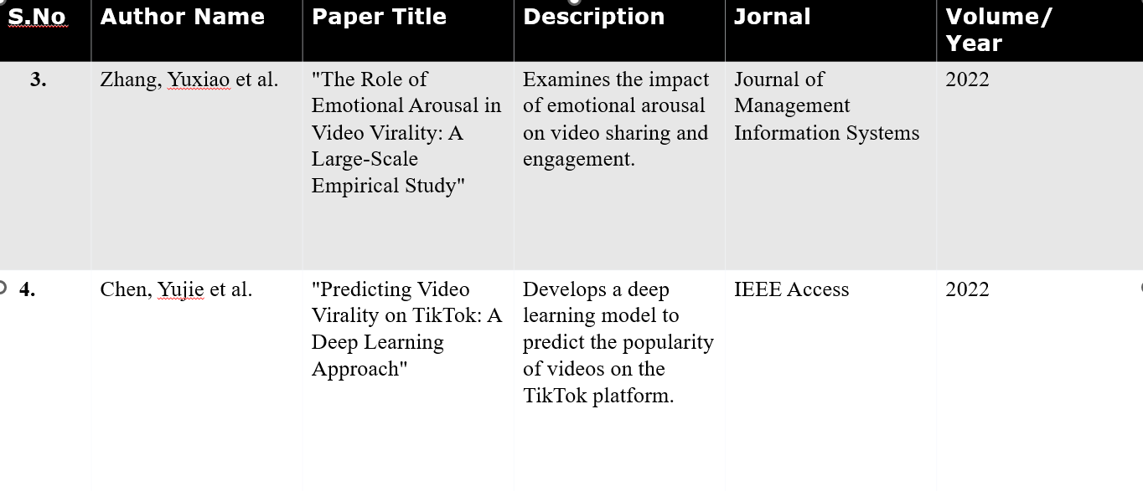
Literature Survey

Slide 8
Existing Sytem
Social Media Analytics Platforms: Tools like Sprout Social or Hootsuite analyze engagement metrics, such as shares and likes, to understand video performance.
Content Tracking Systems: Systems such as BuzzSumo track the spread of video across various social media channels, providing insights into what drives virality.
Influencer Analytics Tools: Platforms like Aspire track influencer effectiveness, helping identify key figures who amplify content reach.
Network Analysis Tools: Tools such as Gephi visualize and analyze social network structures to understand how video spreads through connections.

Slide 9
Drawback of Existing System
Social Media Analytics Platforms: May provide limited insights into the qualitative aspects of video virality.
Content Tracking Systems: Can be expensive and may not capture all relevant social channels or niche communities.
Influencer Analytics Tools: Often focus on influencers alone, potentially overlooking broader sharing patterns and grassroots virality.
Network Analysis Tools: Require complex data processing and can be challenging to interpret without specialized knowledge.

Slide 10
Proposed System
Semantic analysis: Use natural language processing techniques to analyze the content of videos, including topics, sentiment, and emotional triggers.
Visual analysis: Employ computer vision algorithms to analyze visual elements of videos, such as color, composition, and object recognition.
Community detection: Identify communities within social networks to understand how different groups contribute to virality.
Engagement metrics: Track a wider range of engagement metrics beyond likes and shares, such as comments, watch time, and shares on other platforms.
Machine learning: Develop machine learning models to predict the potential virality of videos based on various factors, including content features, user demographics, and network characteristics.

Slide 11
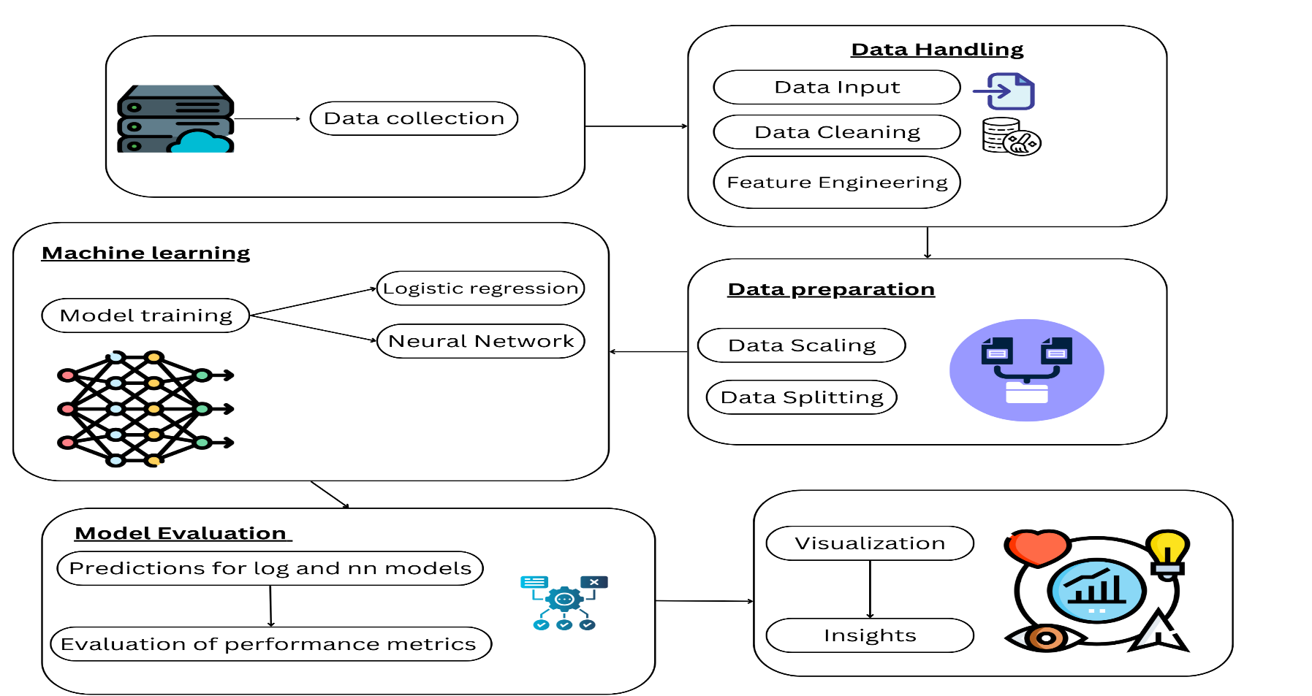
System Architecture

Slide 12
List of modules
Video Data Extraction and Preprocessing Module : This module extracts video metrics from the pytube and prepares the data by performing feature engineering and scaling.
Virality Prediction and Model Evaluation Module: This module applies logistic regression and neural networks to predict video virality and evaluates model performance using key metrics.
User Video Upload Module: This module allows users to input a YouTube video link, validating it and fetching essential metrics from the pytube.
Insights Generation and Recommendations Module : This module analyzes the video data to provide insights and actionable recommendations based on predictive analysis of virality factors.

Slide 13
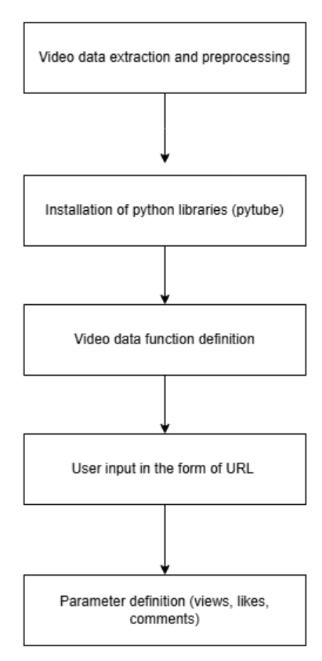
Video Data Extraction and Preprocessing Module DFD

Slide 14
Algorithm Video Data Extraction and Preprocessing Module:
Data Extraction: Call the YouTube API to retrieve video metrics (e.g., views, likes, dislikes, comments).
Feature Engineering: Create new features to help models learn better. Likes dislike ratio = likes/dislikes+1 Views-Likes Ratio = views/likes+1
Handle Missing Data: Fill missing values in the comment_count column with 0.
Feature Scaling: Scale the features using StandardScaler to normalize data for machine learning models: X_scaled=scaler.fit_transform(X)

Slide 15
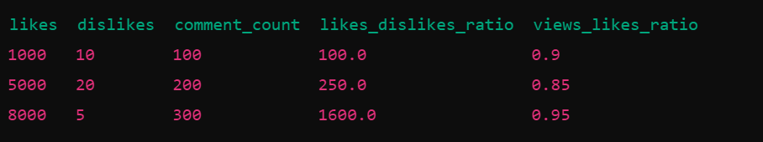
Output for Video Data Extraction and Preprocessing Module

Slide 16
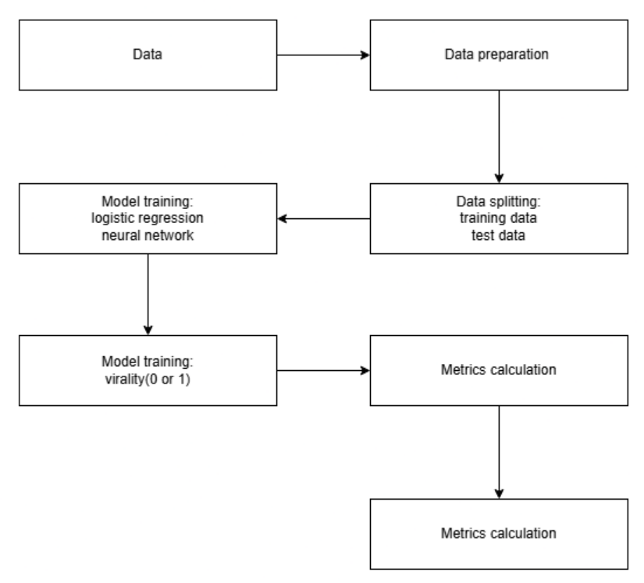
Virality Prediction and Model Evaluation Module DFD

Slide 17
Algorithm Virality Prediction and Model Evaluation Module
z=w^TX+b
[7:51 PM]
z=w^TX+b
[7:51 PM]
Data Splitting: Split the dataset into training and test sets:X_train, X_test, y_train, y_test=train_test_split(𝑋_𝑠𝑐𝑎𝑙𝑒𝑑,𝑦,test_size=0.2)X_train, X_test, y_train, y_test=train_test_split(X_scaled,y,test_size=0.2)
Logistic Regression Model: Train the logistic regression model = log_model.fit(X_train, y_train) Make predictions on test data = y_pred_log=log_model.predict(X_test)
Neural Network Model: Build the model- Sequential()→Dense(input_shape=(X_train.shape[1],))→Dense(activation= ′ sigmoid ′ ) compile and train the model = nn_model.compile()nn_model.fit(X_train, y_train) predictions = y_pred_nn=(nn_model.predict(X_test)>0.5).astype(int)
Model evaluation: accuracy-precision-recall-f1score

Slide 18
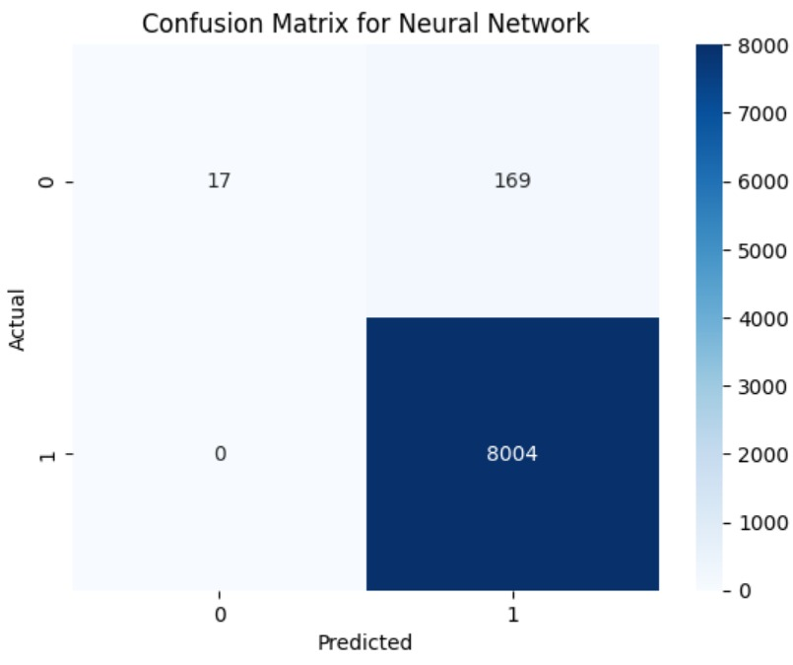
Output for Virality Prediction and Model Evaluation Module

Slide 19
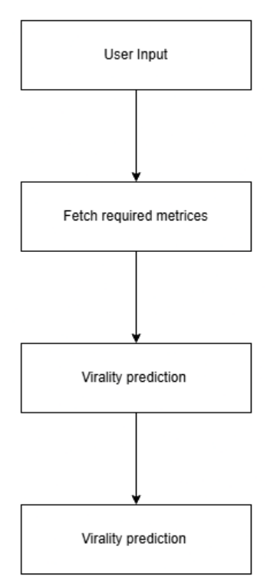
User Video Upload Module DFD:

Slide 20
User Video Upload Module Algorithm:
User Input: A user submits a YouTube video link via the web form.
Fetch Video Metrics: Once validated, use the YouTube API to fetch essential metrics (e.g., views, likes, dislikes, comments).
Pass Metrics to Models: The fetched metrics are passed to the Virality Prediction and Model Evaluation Module for further analysis.

Slide 21
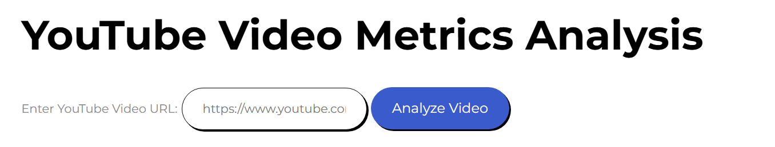
User Video Upload Module output:

Slide 22
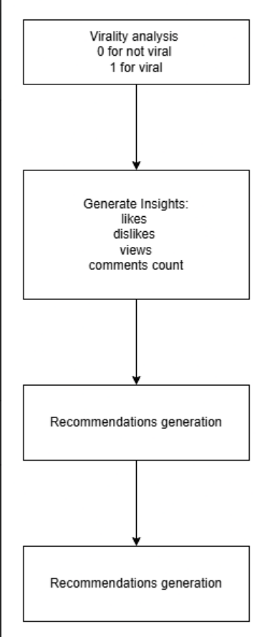
Insights Generation and Recommendations Module DFD

Slide 23
Insights Generation and Recommendations Module Algorithm:
Virality Analysis: The models (logistic regression and neural network) process the video metrics to generate a virality score or prediction
Generate Insights: Analyze the performance of the video based on factors such as high engagement rates and identify which of these metrics contributed most to the video's virality.
Recommendations: Based on the analysis, provide actionable recommendations for improving video performance

Slide 24
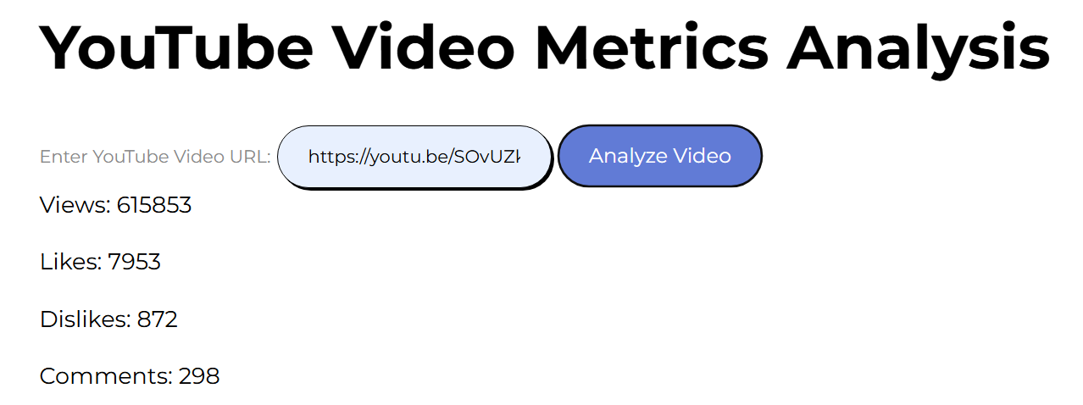
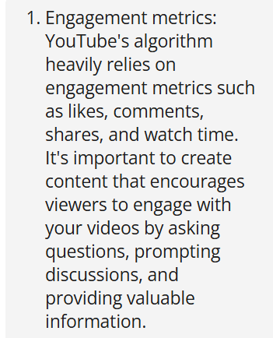
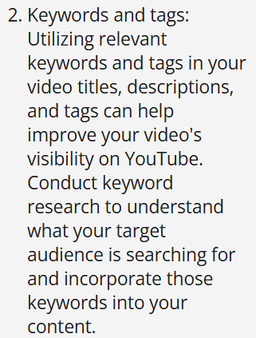
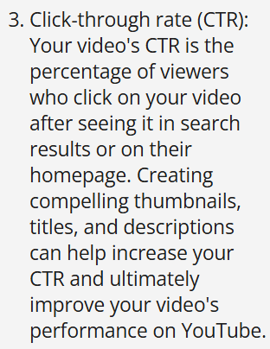
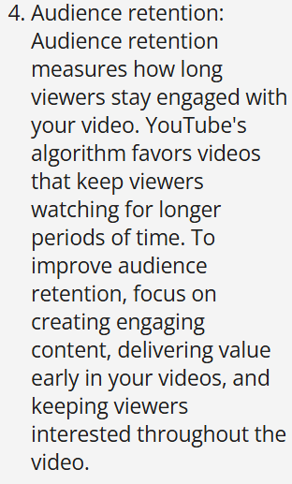
Insights Generation and Recommendations Module Output

Slide 25
Result and Discussion
Prediction Accuracy: The logistic regression and neural network models provided competitive accuracy scores in predicting video virality, with neural networks slightly outperforming in terms of recall and precision.
Key Virality Metrics: Metrics such as views, likes, dislikes, and the like-dislike ratio were strong indicators of virality, influencing the prediction models' outputs.
User Feedback: The website successfully analyzed user-provided YouTube video links and generated insights, offering recommendations on improving virality based on the underlying dataset.
User Engagement Insights: The analysis highlighted that user engagement (e.g., comments and likes) strongly correlates with viral patterns, suggesting strategies like optimizing engagement to boost future video virality.

Slide 26
References.
"Understanding Viral Content Dynamics: A Data-DrivenApproachM. Thompson, L. Clark, IEEE Transactions on Computational Social Systems, vol. 8, Date: March 2021, Pages: 150-162.
"Predicting Content Virality on Social Media Using Machine Learning" J. Williams, S. Brown, IEEE Access, vol. 9, Date: 2021, Pages: 232-244.
"Social Media Analytics for Viral Content: A Comprehensive Review"* P. Chen, R. Gupta, IEEE Transactions on Big Data, vol. 7, Date: September 2020, Pages: 300-315.
"Predicting Content Virality Using Random Forest Algorithm"M. Liu, S. Kumar, IEEE Transactions on Computational Social Systems, vol. 7, Date: August 2020, Pages: 245-258.

Slide 27
Thank You

